Slide 1
Attitude Determination and Control Systems

Slide 2
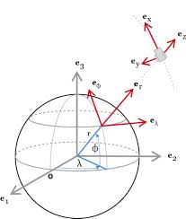
Attitude

Slide 3
Attitude Determination
Sun Sensor
Star Sensor
Magnetic Field Sensor

Slide 4
Estimations
Data Filtering
Data Predictions

Slide 5
Attitude

Slide 6
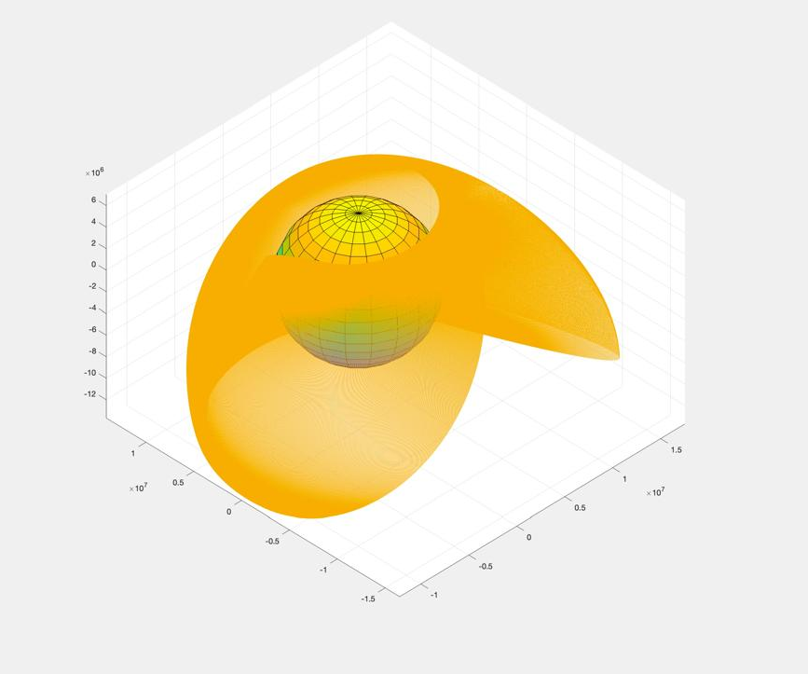
Navigation
Orbit Propagation
Orbital Modes

Slide 7
Control Systems
Modelling Systems

Slide 8
Control System Hardware
Reaction Wheels
Magnetorquers

Slide 9
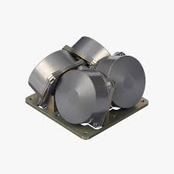
Reaction Wheels

Slide 10
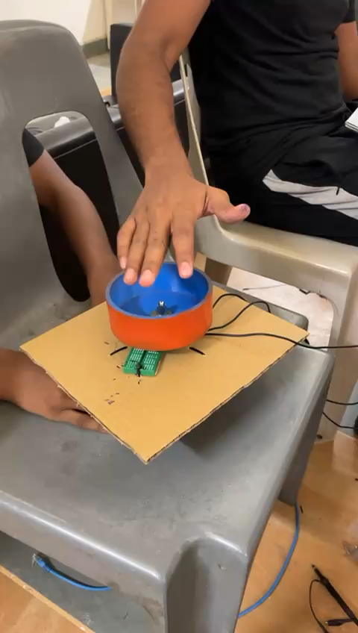
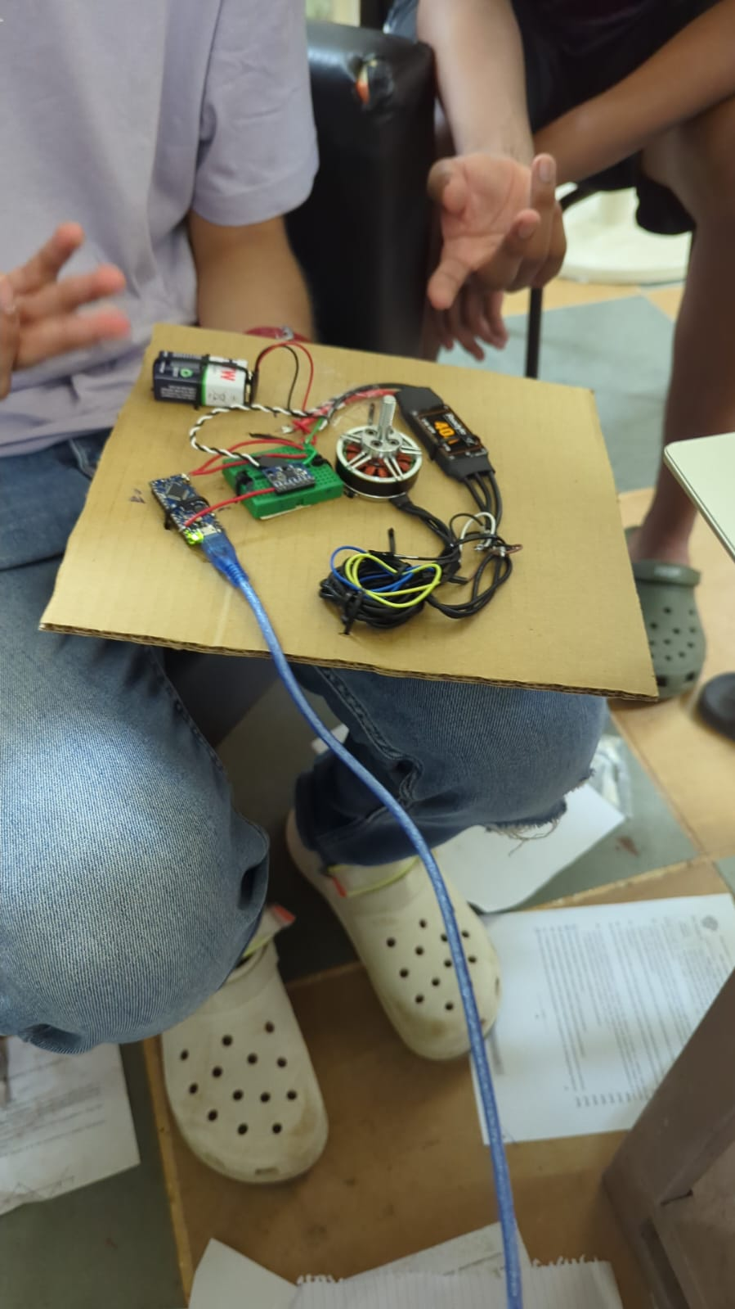
Reaction Wheels

Slide 11
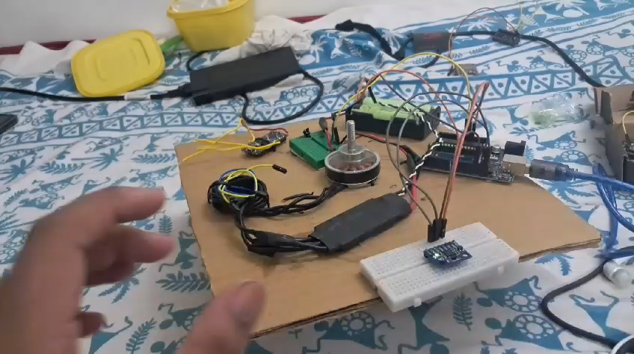
Reaction Wheels

Slide 12
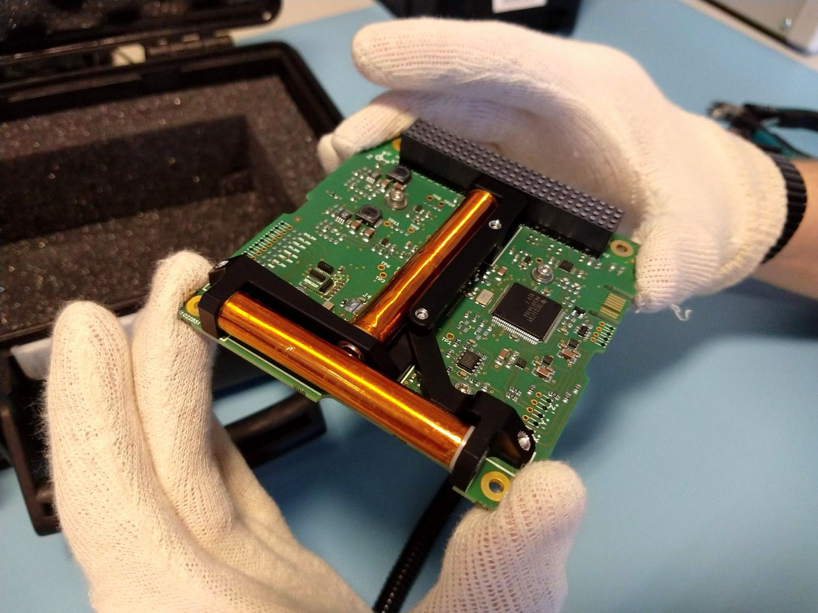
Magnetorquers

